Slide 1

Group & Team Theory (cont.)
Session III

Slide 2
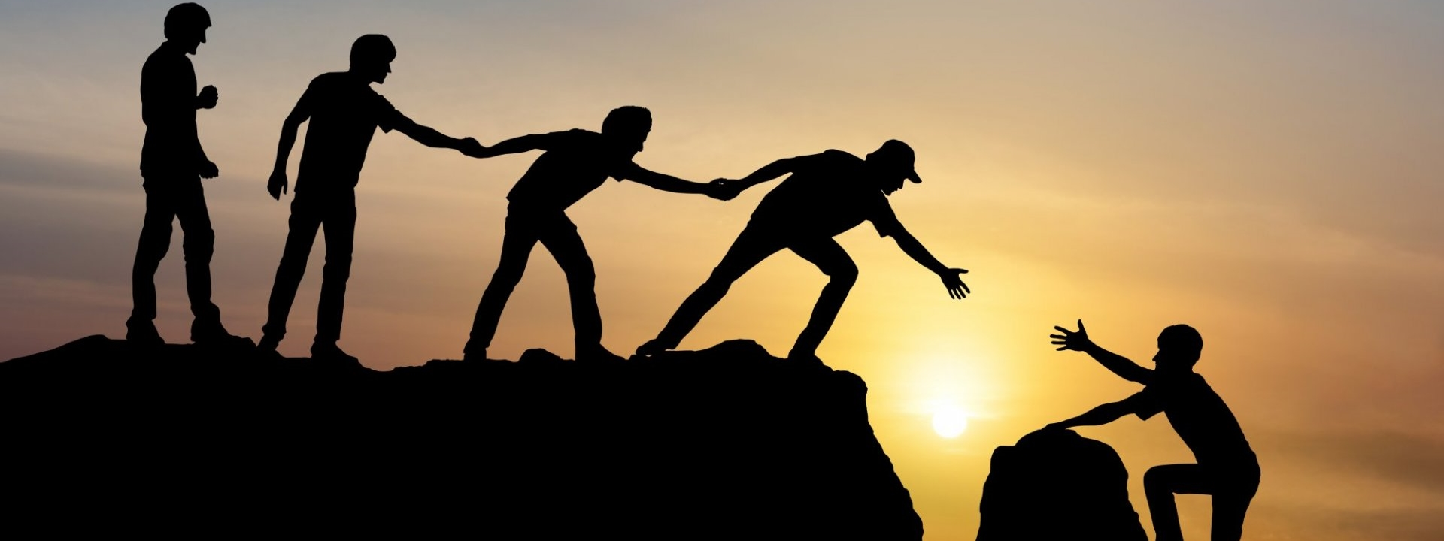
Group & Team Theory (cont.)
2. Leadership
3. Working in Diverse Teams

Slide 3
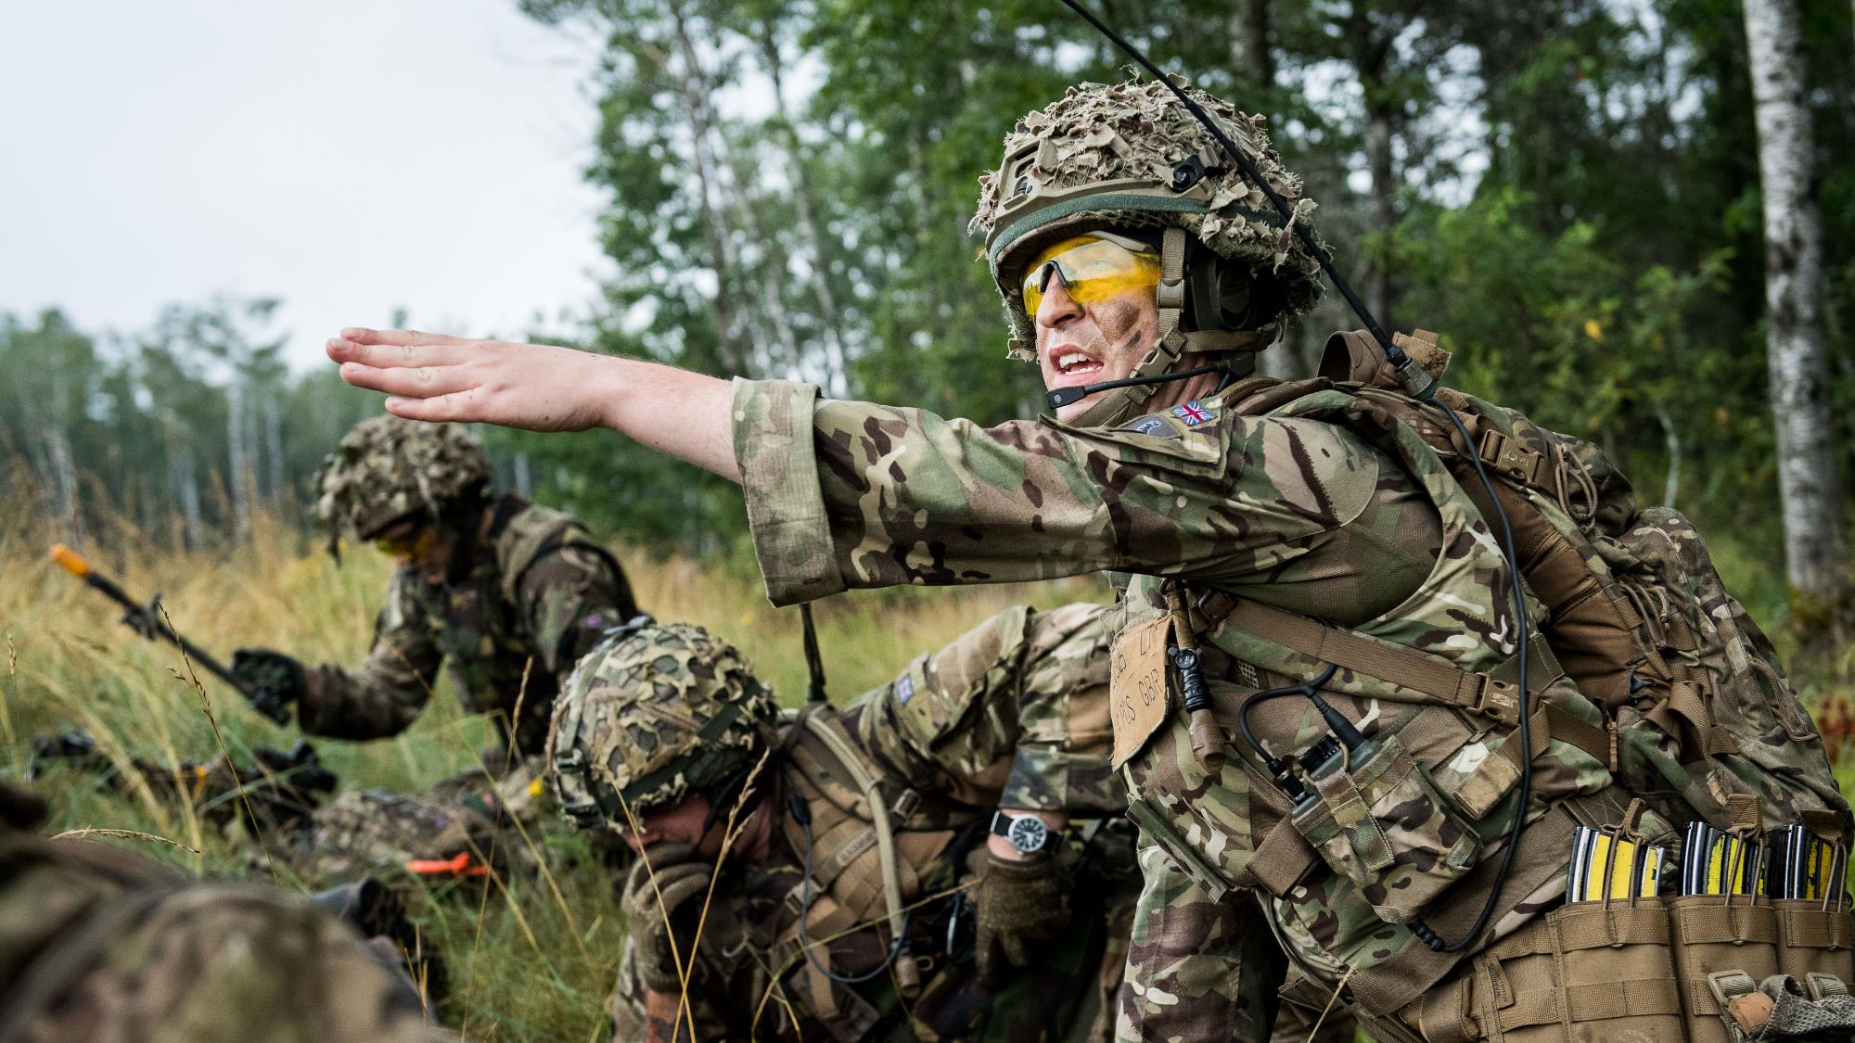
2. Leadership

Slide 4

The Nature of Leadership
What is the nature of leadership and the leadership process?

Slide 5

The Nature of Leadership
Leadership
Leadership is frequently defined as a social (interpersonal) influence relationship between two or more persons who depend on each other to attain certain mutual goals in a group situation.

Slide 6
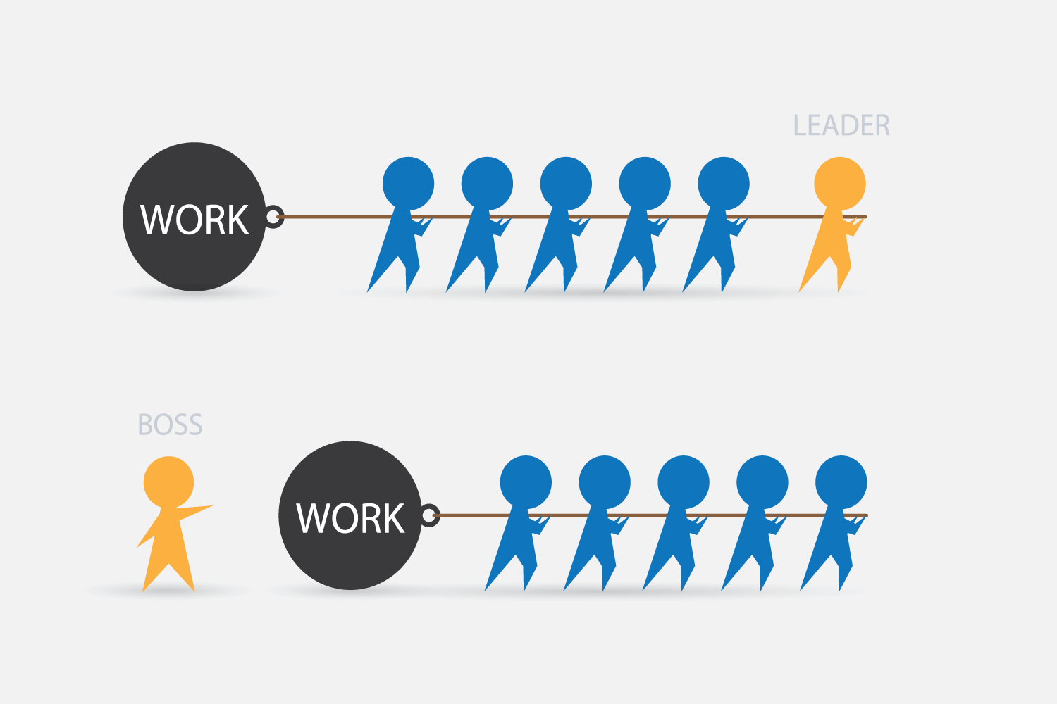
The Nature of Leadership
Leader vs. Manager
LEADER
The two dual concepts, leader and manager, leadership and management, are not interchangeable, nor are they redundant.
The differences between the two can, however, be confusing.
In many instances, to be a good manager one needs to be an effective leader.
BOSS
Effective leadership often necessitates the ability to manage—to set goals; plan, devise, and implement strategy; make decisions and solve problems; and organize and control.

Slide 7
The Nature of Leadership
Leader vs. Manager
Two concepts are defined differently.
Management is defined as a process consisting of planning, organizing, directing, and controlling.
Leadership is defined as a social (interpersonal) influence relationship between two or more people who are dependent on each another for goal attainment.
LEADER
BOSS
Management and Organizational Behavior, https://cnx.org/contents/c3acb2ab-7d5c-45ad-b3cd-e59673fedd4e@8.90:e4112b33-edb8-4e97-943a-859ec40197a7

Slide 8
The Nature of Leadership
Leader vs. Manager
Managers are generally appointed to their role.
Leadership per se is a relationship that revolves around the followers’ acceptance or rejection of the leader. Leaders often emerge out of events that unfold among members of a group.
Managers and Leaders are commonly differentiated in terms of the processes through which they initially come to their position.
LEADER
BOSS

Slide 9
The Nature of Leadership
Managers commonly derive their power from the larger organization.
Leader vs. Manager
Managers and Leaders often differ in terms of the types and sources of the power they exercise.
Leaders can also secure power and the ability to exercise influence using carrots and sticks; however, it is much more common for leaders to derive power from followers’ perception of their knowledge, personality and attractiveness, and the working relationship that has developed between leaders and followers.
LEADER
BOSS

Slide 10
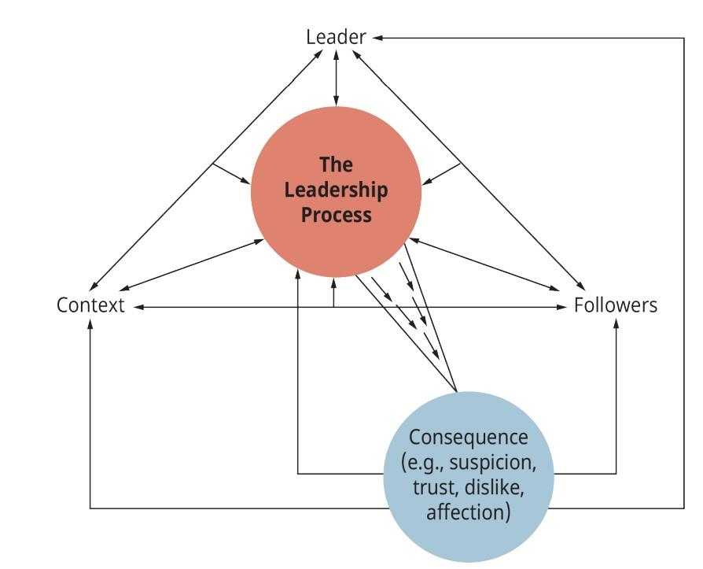
The Nature of Leadership
The Leadership Process
Leadership is a process, a complex and dynamic exchange relationship built over time between leader and follower and between leader and the group of followers who depend on each other to attain a mutually desired goal.
Key components to this “working relationship”: the leader, the followers, the context (situation), the leadership process per se, and the consequences (outcomes).
The Leadership Process
(Attribution: Copyright Rice University, OpenStax, under CC-BY 4.0 license)

Slide 11

The Nature of Leadership
The Leadership Process
The leader
Leaders are people who take charge of or guide the activities of others.

Slide 12

The Nature of Leadership
The Leadership Process
The Context
Refers to the situation that surrounds the leader and the followers.
The Process
Is a complex, interactive, and dynamic working relationship between leader and followers.
The
Consequences
Two outcomes are important:
1. Have the group’s maintenance needs been fulfilled?
2. Have the group’s task needs been met?

Slide 13

Leader Emergence
Organizations have two kinds of leaders:
A formal leader is that individual who is recognized by those outside the group as the official leader of the group.
Informal leaders, by contrast, are not assigned by the organization. The informal leader is that individual whom members of the group acknowledge as their leader.

Slide 14

Paths to Leadership
People come to leadership positions through two dynamics:
In many instances, people are put into positions of leadership by forces outside the group. We refer to these persons as the Designated Leaders (in this instance the designated and formal leader are the same person).
Emergent Leaders, on the other hand, arise from the dynamics and processes that unfold within and among a group of individuals as they endeavor to achieve a collective goal.

Slide 15

DESIGNATED LEADERS (FORMAL LEADER)
Selected by group members or an outside authority
Being designated leader is no guarantee of leadership ability unless the leader’s skills match the group’s needs.
EMERGENT LEADERS (INFORMAL LEADERS)
Gradually achieve leadership by helping the group achieve its goals
Emerging from within a group has the advantage of relying on expert or referent power.

Slide 16
Leadership as an Exercise of Influence
Leadership is the exercise of influence over those who depend on one another for attaining a mutual goal in a group setting.
But how do leaders effectively exercise this influence? Social or (interpersonal) influence is one’s ability to effect a change in the motivation, attitudes, and/or behaviors of others.
Power, then, essentially answers the “how” question: How do leaders influence their followers? The answer often is that a leader’s social influence is the source of his power.

Slide 17
The Leader - Follower Power Relationship
Follower Compliance
Group Effectiveness
Influence/ Power tactic (e.g., use if rationality)
Alineation & Resistance
Calculative compliance
Identification
Internalization – Commitment
Follower satisfaction
Follower motivation
Follower performance
Leader
Effective leadership is more likely to occur when the leader’s influence flows out of rationality, expertise, moralistic appeal, and/or referent power.

Slide 18

Discussion: Leadership Needs in the 21st Century
How do different approaches and styles of leadership impact what is needed now?

Slide 19
Homework: Read and write a reflect essay on one of the following topics:
The Trait Approach to Leadership: What are the trait perspectives on leadership?
Behavioral Approaches to Leadership: What are the behavioral perspectives on leadership?
Situational (Contingency) Approaches to Leadership: Situational (Contingency) Approaches to Leadership: What are the situational perspectives on leadership?
Substitutes for and Neutralizers of Leadership: What does the concept of “substitute for leadership” mean?
Transformational, Visionary, and Charismatic Leadership: What are the characteristics of transactional, transformational, and charismatic leadership?
Notes:
Lecturers should take activity points

Slide 20
Group & Team Theory (cont.)
3. Working in Diverse Teams

Slide 21
Learning Objective
Describe how diversity can enhance decision-making and problem-solving
Identify challenges and best practices for working with multicultural teams
Define conflict
Differentiate between functional and dysfunctional conflict
Recognize various types of conflict in groups
Describe the conflict process
Identify and apply strategies for preventing or reducing conflict in groups

Slide 22

Does Team Diversity Enhance Decision Making and Problem Solving?
Teams made up of diverse members tend to perform better than teams of similar backgrounds.
Here, the Women of Color in Technology work on a project. The tech industry has been criticized for the lack of diversity among its ranks, and groups like the Women of Color in Technology are looking to change that.
(Credit: WOCin Tech Chat/CC BY 2.0)

Slide 23
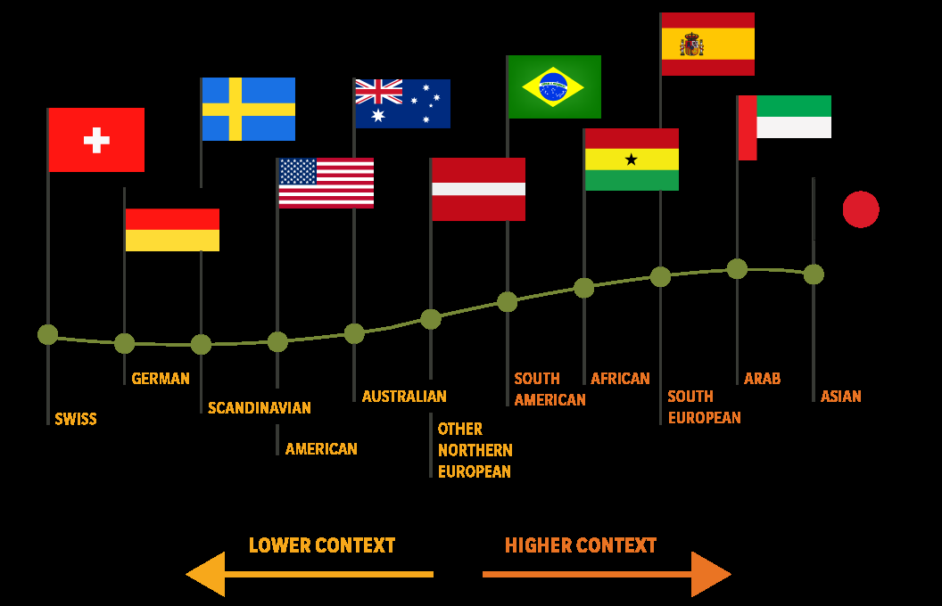
HIGH CONTEXT VS. LOW CONTEXT CONTINUUM
Low-context communication
High-context communication
More direct and explicit
More indirect and ask questions rather than pointing our problems.
Challenges and Best Practices for Working with Multicultural Team

Slide 24
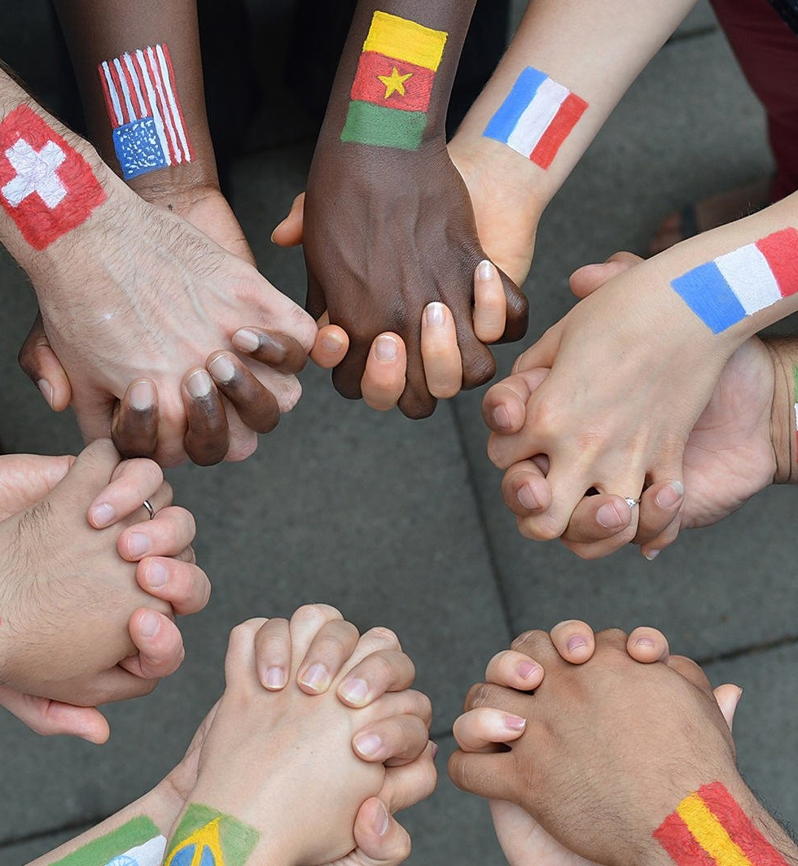
Developing Cultural Intelligence
Cultural intelligence is a competency and a skill that enables individuals to function effectively in cross-cultural environments.
Cultural intelligence develops as people become more aware of the influence of culture and more capable of adapting their behavior to the norms of other cultures.

Slide 25
Best practices recommended for honing cross-cultural skills.
“broaden your mind” - expand your own cultural channels (travel, movies, books) and surround yourself with people from other cultures.
“develop your cross-cultural skills through practice” and experiential learning.

Slide 26



Three sources of cultural intelligence for becoming more adept in cross-cultural skills and understanding: head, body, and heart (Mosakowski, 2004):
We first learns about the beliefs, customs, and taboos of foreign cultures via the HEAD.
This is the cognitive component of cultural intelligence.
The BODY involves more commitment and experimentation with the new culture.
This physical component (demeanor, eye contact, posture, accent) shows a deeper level of understanding of the new culture and its physical manifestations.
The HEART deals with a person’s own confidence in their ability to adapt to and deal well with cultures outside of their own.
Heart really speaks to one’s own level of emotional commitment and motivation to understand the new culture.

Slide 27
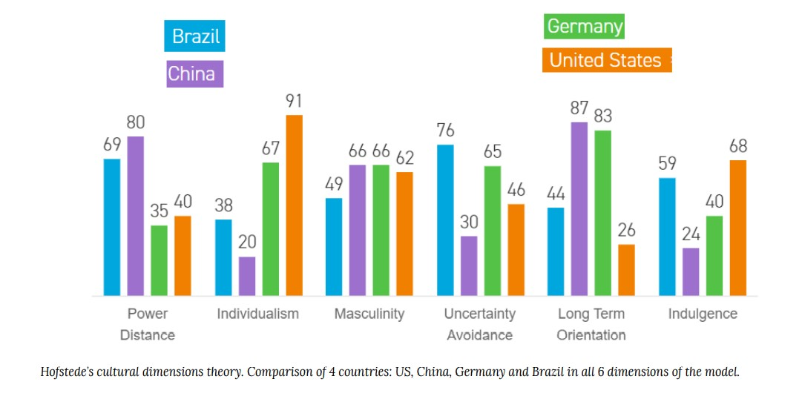
Divergent Cultural Dimensions
Power Distance
Individualism
Masculinity
Uncertainty Avoidance
Long Term Orientation
Indulgence (Time Orientation)

Slide 28
Divergent Cultural Dimensions
POWER DISTANCE
Low-power distance cultures: people relate to one another more as equals and less as a reflection of dominant or subordinate roles, regardless of their actual formal roles as employee and manager (Geert Hofstede).
High-power distance culture: people are less likely to challenge the decision, to provide an alternative, or to give input. Less powerful people are more likely to accept decisions without comment, even if they have a concern or know there is a significant problem.

Slide 29
Divergent Cultural Dimensions
INDIVIDUALISM
Individualism: People in individualistic cultures value individual freedom and personal independence, and cultures always have stories to reflect their values.
In individualistic cultures like the United States, people perceived their world primarily from their own viewpoint. They perceived themselves as empowered individuals, capable of making their own decisions, and able to make an impact on their own lives.
Collectivist cultures including many in Asia and South America, focus on the needs of the nation, community, family, or group of workers.
(Hofstede, 1982)

Slide 30
Divergent Cultural Dimensions
MASCULINITY
The masculine-feminine dichotomy is the extent to which the culture values certain traits that may be considered masculine or feminine (Hofstede, 2009).
“The assertive pole has been called ‘masculine’ and the modest, caring pole ‘feminine.’
The women in feminine countries have the same modest, caring values as the men; in the masculine countries they are somewhat assertive and competitive, but not as much as the men, so that these countries show a gap between men’s values and women’s values” (Hofstede, 2009).

Slide 31
Divergent Cultural Dimensions
UNCERTAINTY AVOIDANCE
Some cultures, such as the United States and Britain, are highly tolerant of uncertainty, while others go to great lengths to reduce the element of surprise.
Cultures in the Arab world, for example, are high in uncertainty avoidance; they tend to be resistant to change and reluctant to take risks.
Whereas a U.S. business negotiator might enthusiastically agree to try a new procedure, the Egyptian counterpart would likely refuse to get involved until all the details are worked out.

Slide 32
Divergent Cultural Dimensions
LONG TERM ORIENTATION
In short-term orientated culture, people place greater emphasis on reciprocation of greetings, gifts, and rewards. While there may be a respect for tradition, there is also an emphasis on personal representation and honor, a reflection of identity and integrity. Personal stability and consistency are also valued in a short-term oriented culture, contributing to an overall sense of predictability and familiarity.
Long-term orientation is often marked by persistence, thrift and frugality, and an order to relationships based on age and status. A sense of shame for the family and community is also observed across generations. What an individual does reflects on the family and is carried by immediate and extended family members.

Slide 33
Divergent Cultural Dimensions
Time Orientation (Indulgence)
Monochronic time-oriented cultures consider one thing at a time, whereas polychronic time-oriented cultures schedule many things at one time, and time is considered in a more fluid sense.
In monochromatic time, interruptions are to be avoided, and everything has its own specific time. The U.S, Germany, and Switzerland are often noted as countries that value a monochromatic time orientation.
Polychromatic time looks a little more complicated, with business and family mixing with dinner and dancing. Greece, Italy, Chile, and Saudi Arabia are countries of polychromatic timing; business meetings may be scheduled at a fixed time, but when they actually begin may be another story.
(Edward T. Hall and Mildred Reed Hall, 1987)

Slide 34

Homework: reading
Low-Power versus High-Power Distance
Masculine versus Feminine Orientation
Uncertainty-Accepting Cultures versus Uncertainty-Rejecting Cultures
Short-Term versus Long-Term Orientation
Time Orientation

Slide 35

Review & Reflection Questions
Why are diverse teams better at decision-making and problem-solving?
What are some of the challenges that multicultural teams face?
How might you further cultivate your own cultural intelligence?
What are some potential points of divergence between cultures?

Slide 36
